Slide 1
Introduction
The Mtcars Plotter is an plotting tool for an exploratory data analysis of the mtcars data set in R. It allows you display diffrent dimensions of the dataset and plot it agains an axis of choice. Furthermore you can display a smoother and facet the rows and columns.
The following dimensions / variables are available
mpg Miles/(US) gallon
cyl Number of cylinders
disp Displacement (cu.in.)
hp Gross horsepower
drat Rear axle ratio
wt Weight (1000 lbs)

Slide 2
ui.R code
library(shiny) library(ggplot2) dataset <- mtcars shinyUI(pageWithSidebar( headerPanel("Mtcars Plotter"), sidebarPanel( sliderInput('sampleSize', 'Sample Size', min=10, max=nrow(dataset), value=min(10, nrow(dataset)), step=5, round=0), selectInput('x', 'X', names(dataset)), selectInput('y', 'Y', names(dataset), names(dataset)[[2]]), selectInput('color', 'Color', c('None', names(dataset))), # checkboxInput('jitter', 'Jitter'), checkboxInput('smooth', 'Smooth'), selectInput('facet_row', 'Facet Row', c(None='.', names(dataset))), selectInput('facet_col', 'Facet Column', c(None='.', names(dataset))) ), mainPanel( plotOutput('plot') ) ))
server.R code
library(shiny) library(ggplot2) shinyServer(function(input, output) { dataset <- reactive( { mtcars[sample(nrow(mtcars), input$sampleSize),] }) output$plot <- reactivePlot(function() { p <- ggplot(dataset(), aes_string(x=input$x, y=input$y)) + geom_point() if (input$color != 'None') p <- p + aes_string(color=input$color) facets <- paste(input$facet_row, '~', input$facet_col) if (facets != '. ~ .') p <- p + facet_grid(facets) # if (input$jitter) # p <- p + geom_jitter() if (input$smooth) p <- p + geom_smooth() print(p) }, height=600 ) })
Sample Grafic generated from the app
This is a sample analysis performed with the shiny app. It shows the miles per US gallon on the x-axis, and horse power on the y-axis. The color is representing the weight (lighter is heavier). The plot is in 2 facet rows, upper plot shows cars with automatic transmission the lower with manual transmission.

Slide 3
server.R code
library(shiny) library(ggplot2) shinyServer(function(input, output) { dataset <- reactive( { mtcars[sample(nrow(mtcars), input$sampleSize),] }) output$plot <- reactivePlot(function() { p <- ggplot(dataset(), aes_string(x=input$x, y=input$y)) + geom_point() if (input$color != 'None') p <- p + aes_string(color=input$color) facets <- paste(input$facet_row, '~', input$facet_col) if (facets != '. ~ .') p <- p + facet_grid(facets) # if (input$jitter) # p <- p + geom_jitter() if (input$smooth) p <- p + geom_smooth() print(p) }, height=600 ) })
Sample Grafic generated from the app
This is a sample analysis performed with the shiny app. It shows the miles per US gallon on the x-axis, and horse power on the y-axis. The color is representing the weight (lighter is heavier). The plot is in 2 facet rows, upper plot shows cars with automatic transmission the lower with manual transmission.

Slide 4
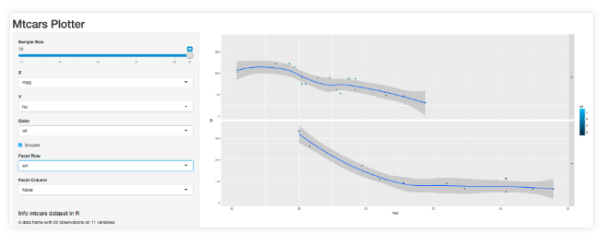
Sample Grafic generated from the app
This is a sample analysis performed with the shiny app. It shows the miles per US gallon on the x-axis, and horse power on the y-axis. The color is representing the weight (lighter is heavier). The plot is in 2 facet rows, upper plot shows cars with automatic transmission the lower with manual transmission.

